Slide 1



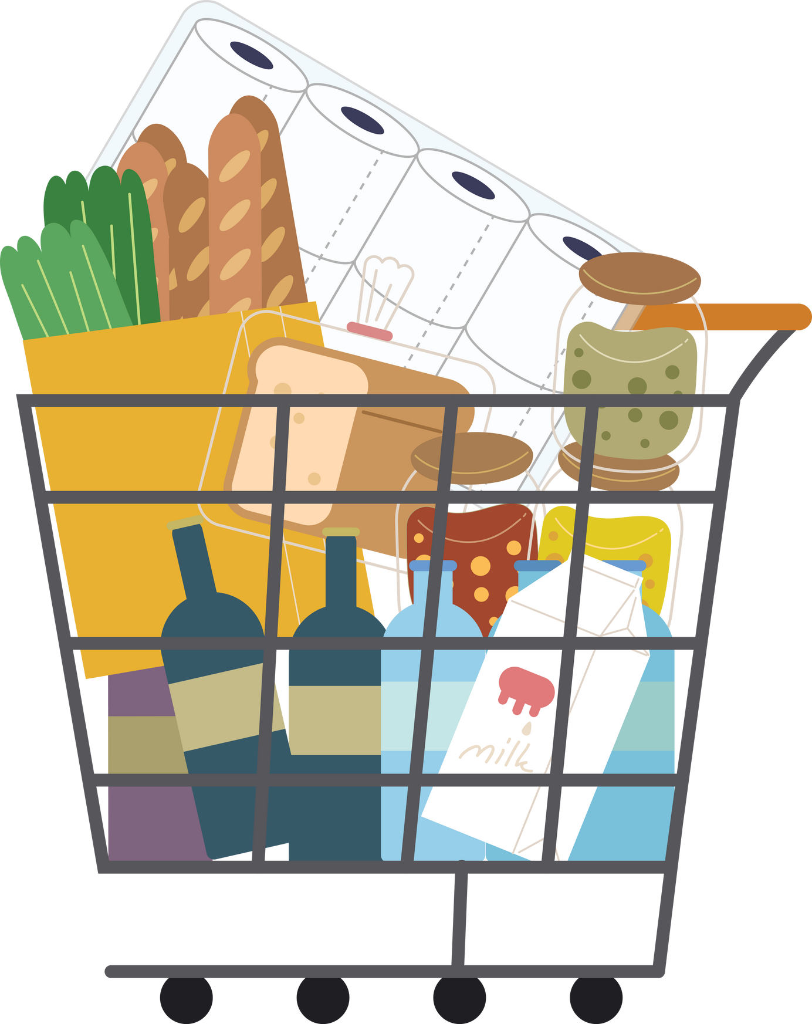



Team Vision
Anshuman Singh, Pratyush Chauhan & Abhishek Verma

Slide 2








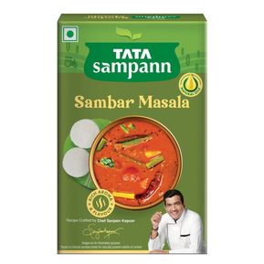
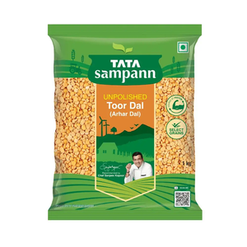
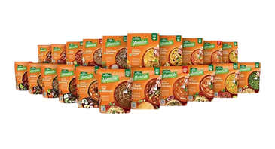

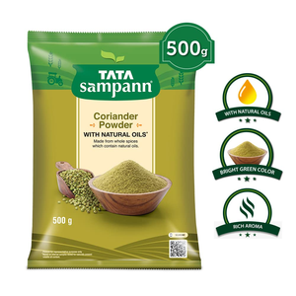
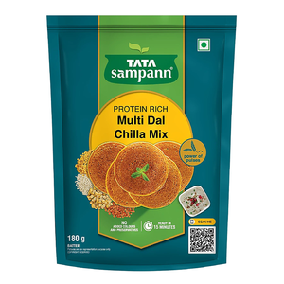
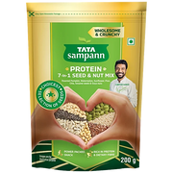

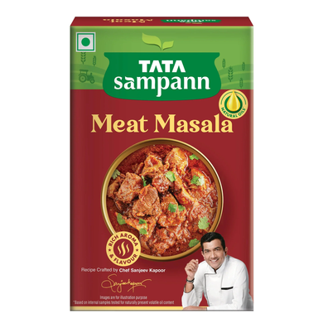

Identifying The Opportunities and Portfolio Analysis
MOSCOW Prioritization
OPPORTUNITY IDENTIFICATION
MUST HAVE
SHOULD HAVE
STEP 1: Market Trends Analysis
Study emerging trends, such as consumer preferences for health-conscious and region-specific foods.
Example: Growing demand for convenience and authenticity in ready-to-cook products.
Expand ready-to-cook product range with health-focused and convenient options.
Strengthen distribution through e-commerce and partnerships with local retailers
Introduce region-specific variants to cater to local tastes.
Promote sustainability with eco-friendly packaging and branding.
STEP 2: Competitor Benchmarking
Evaluate competitors’ products, pricing, distribution, and marketing strategies.
Identify gaps where Tata Sampann can offer differentiated products.
COULD HAVE
WON’T HAVE
Explore international markets targeting the Indian diaspora.
Develop subscription models for essential products like pulses and spices.
Avoid diversification into non-core product categories.
Limit investment in low-demand or niche market segments.
STEP 3: Consumer Needs Assessment
Conduct surveys and focus groups to understand unmet needs.
Example: Millennials and working professionals seeking quick, healthy meals.
BCG MATRIX OF TATA SAMPANN PRODUCT
STEP 4: Portfolio Gaps Analysis
Analyze existing product categories and identify underrepresented or untapped areas.
Example: Low penetration of RTC mixes in Tier 2 and Tier 3 cities.
Pulses and Masala
RTC Product
STEP 5: Scoring and Prioritization
Use criteria like market size, growth potential, alignment with brand, and feasibility to rank opportunities.
Single-ingredient masalas
Niche RTC Mixes and others

Slide 3









Insights from primary & secondary research:
the why to our solutions
What did we do?
Consumer Insights
Focus group
interviews (n-20)
Consumer survey
(n-110)
What was our reach?
72% of urban households seek products that reduce cooking time while maintaining authenticity
63% of Indian consumers prefer region-specific flavors
Millennials and working professionals are primary drivers of the RTC market in Tier 1 and Tier 2 cities
Tier 1 Cities: Delhi, Mumbai, Bangalore, Hyderabad, Chennai
Tier 2 Cities: Guwahati, Jaipur, Lucknow, Indore, Patna, Jammu, Kanpur
1. Product Awareness and Usage Frequency | 1. Product Awareness and Usage Frequency | 1. Product Awareness and Usage Frequency | 1. Product Awareness and Usage Frequency
City Tier | Aware of Ready-to-Cook Products (%) | Use Weekly or More Often (%) | Use Monthly or Less (%)
Tier 1 | 85% | 45% | 30%
Tier 2 | 55% | 25% | 40%
2. Factors Driving Purchase Decision | 2. Factors Driving Purchase Decision | 2. Factors Driving Purchase Decision
Factors | Tier 1 (%) | Tier 2 (%)
Convenience | 65% | 45%
Health-conscious options | 40% | 25%
Taste & Variety | 35% | 50%
Brand reputation | 55% | 45%
Online Availability | 50% | 35%
2
Whom did we meet?
3. Preferred Product Categories | 3. Preferred Product Categories | 3. Preferred Product Categories
Product Type | Tier 1 | Tier 2
Breakfast Items | 40% | 30%
Main Course (Curries, Gravies) | 60% | 50%
Desserts & Sweets | 30% | 25%
Soups & Beverages | 25% | 20%
Existing Tata
Sampann Consumer
Bachelors and working professionals
Tier 1 cities exhibit higher awareness and frequent use of ready-to-cook products driven by convenience and variety, with a preference for breakfast items, while Tier 2 cities show moderate awareness, occasional usage, and prioritize affordability with a focus on snacks and main courses.

Slide 4








Value proposition and Positioning
Value proposition canvas
GAIN CREATOR
Authentic regional flavors (e.g., Pongal Mix, Rajma-Chawal Mix).
High-quality, unpolished ingredients retaining natural oils.
GAINS
Desire for preservative-free, natural ingredients, and authentic flavors.
PRODUCTS AND
SERVICES
JOBS TO BE DONE
Natural ingredient ready-to-cook mixes.
Regional RTC mixes with high quality, preservatives free ingredients and eco friendly packaging.
Quick, healthy, and authentic meals with minimal effort.
PAIN RELIEVERS:
PAINS
Saves time with easy-to-cook options.
Provides consistency in taste.
Offers health benefits with preservative-free ingredients.
Lack of time for scratch cooking, inconsistent taste, and unhealthy ready-to-eat optionsrt.
4C’s of Positioning
Tata Sampann RTC Mixes are positioned to offer the best of both worlds: the authentic taste of regional Indian cuisine and the assurance of high-quality ingredients, all at a price point that is accessible to the average consumer. This positioning highlights the brand's commitment to delivering value through superior taste, quality, and affordability.
Company
Customers
75%
Millennials, working professionals, and nuclear families.
Preference for healthy, quick, and authentic meals.
35%
Ready-to-Cook Indian regional dishes.
Differentiation: Focus on authenticity and health.
Capabilities
Collaborators
50%
Direct: ITC Kitchens of India, MTR, Knorr.
Indirect: Home-cooked meals, scratch cooking.
100%
Tata Sampann’s strong brand equity ensures consumer trust in quality and authenticity.

Slide 5





Our Big Idea
Onboarding Process via AIDA
Paid digital ads targeting key demographics.
Regional festivals as platforms to promote products (e.g., Pongal in Tamil Nadu).
REACH
A
I
D
A
Encourage trials via sampling and bundled offers.
Interactive content (e.g., cooking tutorials, recipe ideas).
ACT
ATTENTION
INTEREST
DESIRE
ACTION
Strategy
Strategy
Strategy
Strategy
Drive purchases with limited-time offers and cashbacks.
Highlight health and authenticity benefits on packaging.
Digital campaigns titled "India in Every Pack" to highlight authentic regional flavors.
Sampling programs in supermarkets and retail stores.
Emotional connect through regional pride and health-focused messaging.
Trial packs and introductory discounts.
CONVERT
Execution
Execution
Execution
Execution
Build loyalty through subscription options on e-commerce platforms.
Regularly update recipes and regional food stories on social media channels.
Create a customer loyalty program that offers exclusive discounts, early access to new products, and special rewards for repeat purchases.
Partner with influencers and chefs for recipe demonstrations. And sponsored ads on Social media targeting millennials and urban professionals.
In-store cooking demos showcasing the convenience and authenticity of RTC mixes. QR codes on packages linking to recipes and interactive content.
Ads showcasing stories of ingredients sourced from native regions.
Messaging like "Healthy, Authentic, and Fast—Just Like Home."
Launch smaller trial packs priced at ₹20-₹30 to encourage first-time buyers.
Cashback offers on e-commerce platforms for repeat purchases.
ENGAGE

Slide 6


Financial Analysis for Tata Sampann RTC
COST-PRICE-PROFITABILITY PYRAMID
1. Raw Materials & Packaging:
RTC Mixes: ₹25-30 (ingredients), ₹5-7 (packaging).
Meal Kits: ₹35-40 (ingredients), ₹10-12 (packaging).
Net
Profit
Margin
15-20%
Target Retail Price
1. RTC Mixes: ₹80-100 (40-50% gross margin).
2. Meal Kits: ₹120-150 (40-50% gross margin)
2. Economies of Scale:
Cost reductions of 5-10% with higher production volumes.
Value Contribution (₹ per Unit)
Total Costs per Unit
1. Regional RTC Mixes: ₹40-50 per unit.
2. Healthy Meal Kits: ₹60-70 per unit.
3. Break-even Points:
RTC Mixes: ~10,000 units/month.
Meal Kits: ~7,000 units/month.
Financial Components (Cost, Price, Profit)
4. Marketing & Distribution:
₹5-7 per unit distribution cost.
10% of revenue allocated for promotions
KEY INSIGHTS:
Efficient sourcing and production control ensure cost management.
Premium pricing strategy aligns with brand positioning.

